Slide 1
Customer Credit and Buying Profile in E-commerce
PIP104 PROFESSIONAL PRACTICE-II
VIVA-VOCE
Batch Number: 7C33
Roll Number | Student Name
20201CEI0158 | MR. ARNAV GUPTA
20201CEI0155 | MR. JATIN KUMAR
20201CEI0180 | MS. KUMARI PUJA SHARMA
20201CEI0175 | MS. C. LIKITHA
20201CEI0109 | MR. VIRAJ MAGDUM
Under the Supervision of,
Dr. Pallavi M
Assistant Professor
School of Computer Science Engineering & Information Science
Presidency University

Slide 2
Introduction
This research introduces a pioneering system aimed at revolutionizing e-commerce through personalized credit and purchasing profiles. By leveraging cutting-edge technologies such as big data analytics, machine learning, and statistical analysis, it seeks to uncover profound insights into customer behaviors. This depth of understanding enables businesses to go beyond traditional segmentation, crafting intricate profiles that consider not only purchasing patterns but also individual creditworthiness. This approach allows for tailored services, such as personalized delivery benefits and flexible payment options, aligned with each customer's financial preferences.
Moreover, a paramount focus on safeguarding customer privacy is evident throughout. The system incorporates state-of-the-art anonymization and aggregation techniques, ensuring the protection of sensitive customer information. Ethical considerations are emphasized, including transparency, user consent, and strict compliance with privacy regulations, establishing a model that combines technological advancement with ethical obligations in today's digital age.
Addressing the complex legal landscape surrounding data privacy and protection, the research advocates for a principled approach. It recognizes potential challenges and pitfalls, providing e-commerce platforms with a comprehensive roadmap. This roadmap aims to guide the implementation of a system that respects privacy while effectively customizing services for customers. This holistic approach aligns technological sophistication with ethical and legal imperatives, shaping a future where e-commerce thrives while prioritizing customer privacy and service personalization.

Slide 3
Literature Review
Credit Scoring:
1. Wang and Yang (2020): Employed an unspecified ML model achieving 85.71% accuracy in credit scoring for bank credit cards, showcasing ML's efficacy in financial risk assessment.
2. Zhang et al. (2020): Explored multi-source data (personal information + credit card data) for credit scoring but lacked accuracy reports, suggesting potential for improved accuracy by leveraging diverse data sources.
3. Maheshwari et al. (2019): Utilized RFM strategy and K-means clustering for e-commerce customer segmentation, demonstrating high accuracy with SVM (87%) and Random Forest (99%) algorithms, aiming to identify genuine and fraud customers to minimize losses.
Customer Segmentation:
1. Wu et al. (2022): Introduced an enhanced k-medoids clustering algorithm for e-commerce customer segmentation, showing improved results compared to standard algorithms.

Slide 4
Literature Review
2. Various studies, including Dursun and Caber (2016), Christy et al. (2021), Dogan et al. (2018), etc.: Applied RFM and clustering methods for customer segmentation, demonstrating their effectiveness in different contexts without specific accuracy metrics.
3. Cheng and Chen (2009): Achieved 85.6% accuracy by combining RFM with rough set theory, indicating the potential of hybrid approaches for enhanced customer value assessment.
4. Brahmana et al. (2020): Compared clustering algorithms for RFM-based segmentation, highlighting the superiority of k-means, offering insights into algorithm selection based on data characteristics.
5. Hossain et al. (2023): Explored the impact of technology on SME e-commerce adoption, emphasizing the significant role of ICT adoption, internet connectivity, and business data management in promoting e-commerce success for SMEs.
This condensed summary captures the essence of the studies, focusing on credit scoring methods, customer segmentation approaches, and the role of technology in SME e-commerce adoption without delving into specific details or accuracy metrics for each study.

Slide 5
Research Gaps Identified
Despite the advancements in credit scoring and customer segmentation methods discussed in the literature review, several research gaps persist, presenting opportunities for further exploration and improvement:
Algorithmic Transparency and Interpretability
Incorporation of Advanced Machine Learning Techniques
Dynamic and Adaptive Models
Integration of Alternative Data Sources
Ethical Considerations and Bias Mitigation

Slide 6
Research Gaps Identified
Real-Time Processing and Adaptation
Evaluation Metrics and Benchmarking
Generalizability Across Industries and Regions
Privacy-Preserving Techniques
User-Centric Approaches
Addressing these research gaps can contribute to the refinement and advancement of credit scoring and customer segmentation methods, making them more reliable, ethical, and adaptable to the evolving landscape of e-commerce.

Slide 7
Proposed Methodology
Data Preprocessing Methods
Concatenation
Handling Missing Values
Date Conversion and Time-Based Feature Engineering
Feature Extraction Methods
Grouping and Aggregation
Return Count Calculation
Payment Method Frequency
Credit Score Calculation
Categorization into Classes

Slide 8
Objectives
Develop an innovative methodology for customer credit scoring in e-commerce
Implement a privacy-centric approach to data handling
Prioritize ethical considerations in credit scoring
Reduce scope of error and maximize accuracy

Slide 9
System Design & Implementation
Comprehensive Experimental Setup: The development of a robust customer credit scoring system for e-commerce involved meticulous preprocessing of the dataset (df4), including concatenation of data from d1.csv and d2.csv, handling missing values, and time-based feature engineering. This preprocessing prepared the dataset for the application of machine learning models.
Diverse Machine Learning Models and Feature Selection: The experimental design incorporated a variety of machine learning models, such as k-Nearest Neighbors, Decision Tree, Support Vector Machine, Random Forest, and Random Forest with Polynomial Features. Feature selection for credit scoring predictions included Recency, Frequency, TotalCost, paymtd (payment method), and Return_Count (return count), providing a comprehensive set of variables. This diversity aimed to evaluate customer creditworthiness effectively.
Thorough Performance Evaluation: The experimental implementation involved training and testing each machine learning model on separate dataset subsets to simulate real-world scenarios. Performance evaluation metrics such as accuracy, precision, recall, F1 score, and Cohen’s Kappa were employed for a nuanced assessment. This multifaceted evaluation allowed for a comparative analysis, identifying the most effective approach for predicting customer credit scores in dynamic e-commerce environments.

Slide 10
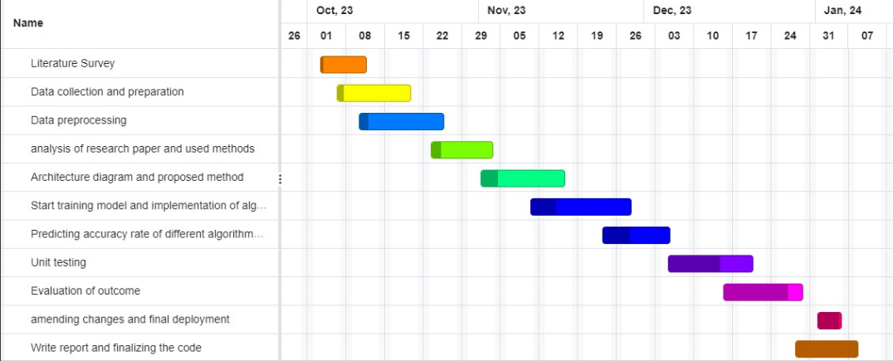
Timeline of Project

Slide 11
Outcomes
Model Performance Insights: Comprehensive experimentation with machine learning models for e-commerce credit scoring reveals notable variations in performance. The k-Nearest Neighbors (KNN) classifier, despite a reasonable 80.15% accuracy, showed sensitivity to outliers, emphasizing the importance of outlier handling for robustness.
Standout Performers: The Decision Tree model demonstrated high accuracy (92.26%) even with outliers, highlighting its reliability in predicting customer credit scores in e-commerce. The Random Forest model consistently performed well, achieving an accuracy of 94.62% with outliers and 95.44% without outliers. Introducing Polynomial Features in Random Forest led to a remarkable accuracy improvement to 96.64%.
Importance of Outlier Handling and Feature Engineering: The Support Vector Machine (SVM) model's significant decline in accuracy without outliers (from 87.30% to 41.46%) emphasizes the importance of proper outlier handling in SVM for credit scoring. The outcomes underscore the potential benefits of feature engineering, especially evident in the enhanced performance of the Random Forest model with Polynomial Features. Overall, the findings highlight the significance of model selection, outlier handling, and feature engineering for robust credit scoring systems in dynamic e-commerce environments.

Slide 12
Results Obtained
WITH OUTLIERS
 | KNN | SVM | DECISION TREE | RANDOM FOREST
ACCURACY | 0.801514 | 0.873003 | 0.922624 | 0.946173
PRECISION | 0.80222 | 0.875365 | 0.92288 | 0.947016
RECALL | 0.801514 | 0.873003 | 0.922624 | 0.946173
F1 SCORE | 0.801827 | 0.872875 | 0.922716 | 0.946263
KAPPA | 0.720432 | 0.819273 | 0.89098 | 0.923896
WITHOUT OUTLIERS
 | KNN | SVM | DECISION TREE | RANDOM FOREST
ACCURACY | 0.787419 | 0.414634 | 0.925163 | 0.954447
PRECISION | 0.789158 | 0.313272 | 0.925945 | 0.95452
RECALL | 0.787419 | 0.414634 | 0.925163 | 0.954447
F1 SCORE | 0.78781 | 0.248638 | 0.925282 | 0.954408
KAPPA | 0.668986 | 0.0107869 | 0.883286 | 0.928323

Slide 13
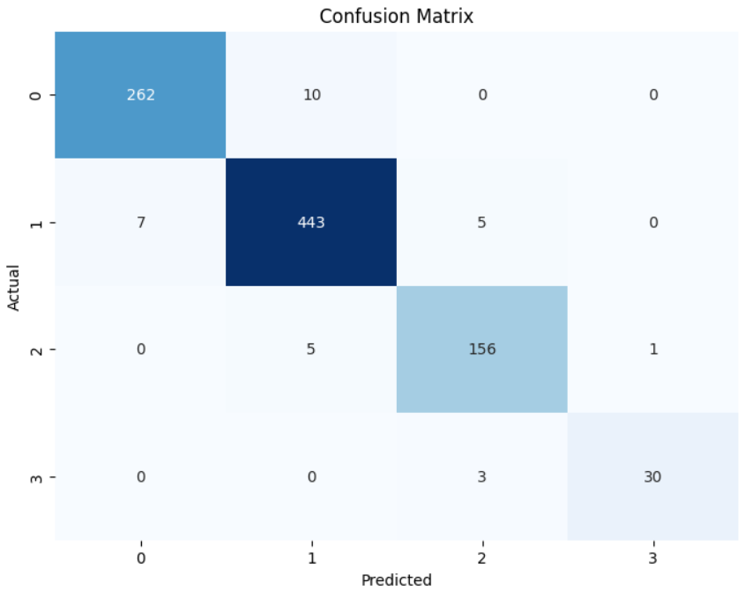
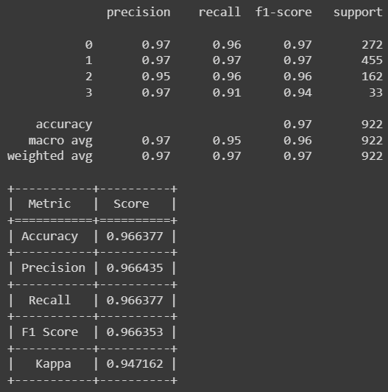
Results Obtained
Random Forest with Polynomial Features
CONFUSION MATRIX
CLASSIFICATION REPORT, EVALUATION METRICS

Slide 14
Conclusion
Model Effectiveness Insights: The research highlights the consistent high performance of Decision Tree and Random Forest models in predicting customer credit scores within e-commerce, achieving accuracies of 92.26% and 94.62%, respectively. This underscores their suitability for credit scoring tasks in this domain.
Role of Data Preprocessing: The efficacy of the SVM model, especially with outliers, emphasizes the critical role of data preprocessing in ensuring model effectiveness. The findings underscore the significance of thoughtful model selection and thorough data preprocessing for the development of reliable credit scoring systems in e-commerce.
Future Research Directions: The research suggests future exploration into advanced feature engineering methods and the integration of ensemble models to further enhance the robustness and adaptability of credit scoring systems in the dynamic e-commerce landscape. Continued refinement and innovation in these areas aim to contribute to the development of more sophisticated and reliable credit scoring systems that meet the evolving demands of the e-commerce industry.

Slide 15
References
[1] Maoguang Wang and Hang Yang. Research on customer credit scoring model based on bank credit card. In Intelligent Information Processing X: 11th IFIP TC 12 International Conference, IIP 2020, Hangzhou, China, July 3–6, 2020, Proceedings 11, pages 232–243. Springer, 2020.
[2] Haichao Zhang, Ruishuang Zeng, Linling Chen, and Shangfeng Zhang. Research on personal credit scoring model based on multi source data. In Journal of Physics: Conference Series, volume 1437, page 012053. IOP Publishing, 2020.
[3] Kirti Maheshwari, Ria Khapekar, Anmol Bahl, and Kunal Bhatia. Credit profile of e-commerce customer. 2019.
[4] Zengyuan Wu, Lingmin Jin, Jiali Zhao, Lizheng Jing, and Liang Chen. Research on segmenting e-commerce customer through an improved k-medoids clustering algorithm. Computational Intelligence and Neuroscience, 2022, 2022.
[5] Aslıhan Dursun and Meltem Caber. Using data mining techniques for profiling profitable hotel customers: An application of rfm analysis. Tourism management perspectives, 18:153–160, 2016.
[6] A Joy Christy, A Umamakeswari, L Priyatharsini, and A Neyaa. Rfm ranking–an effective approach to customer segmentation. Journal of King Saud University-Computer and Information Sciences, 33(10):1251–1257, 2021.
[7] Onur Dogan, Ejder Ayçin, and Zeki Bulut. Customer segmentation by using rfm model and clustering methods: a case study in retail industry. International Journal of Contemporary Economics and Administrative Sciences, 8, 2018. [8] Ching-Hsue Cheng and You-Shyang Chen. Classifying the segmentation of customer value via rfm model and rs theory. Expert systems with applications, 36(3):4176–4184, 2009. [9] RW Sembiring Brahmana, Fahd Agodzo Mohammed, and K Chairuang. Customer segmentation based on rfm model using k means, k-medoids, and dbscan methods. Lontar Komput. J. Ilm. Teknol. Inf, 11(1):32, 2020.
[10] İnanç Kabasakal. Customer segmentation based on recency frequency monetary model: A case study in e-retailing. Bilişim Teknolojileri Dergisi, 13(1):47–56, 2020.
[11] Uus Firdaus and D Utama. development of bank’s customer segmentation model based on rfm+ b approach. Int. J. Innov. Comput. Inf. Cont, 12(1):17–26, 2021.
[12] Md Billal Hossain, Nargis Dewan, Aslan Amat Senin, and Csaba Balint Illes. Evaluating the utilization of technological factors to promote e-commerce adoption in small and medium enterprises. Electronic Commerce Research, pages 1–20, 2023.

Slide 16
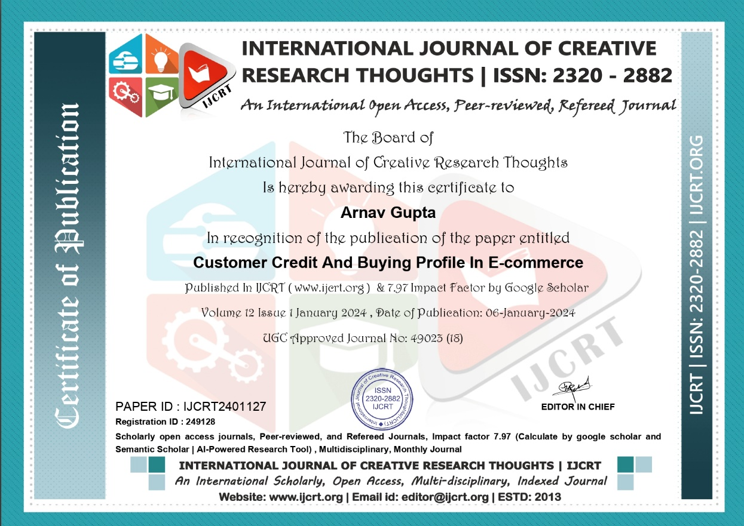
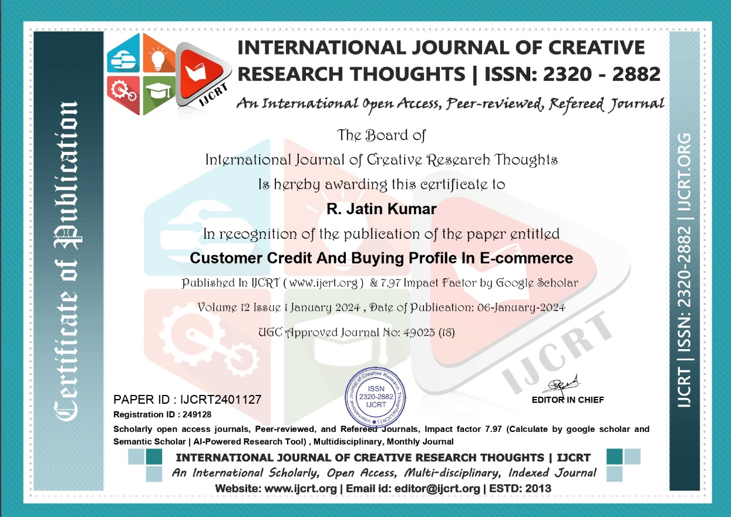
Publication Details

Slide 17


Publication Details

Slide 18

Publication Details

Slide 19
Achievements (if any)

Slide 20

Thank You

